Slide 1


Slide 2
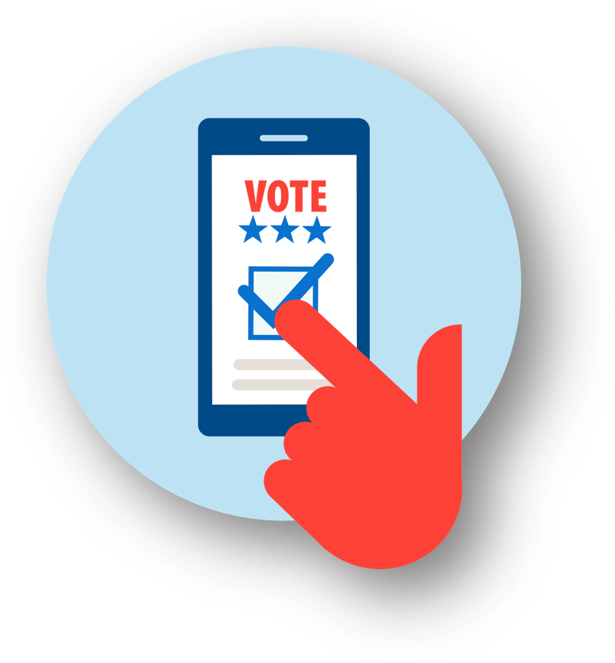
The Purpose of a Let's Talk Dialogue
To weigh different approaches for addressing a problem and exchange views with others on what should be done
Welcome to Let's Talk, Marathon County
2024

Slide 3
Today’s Dialogue
1.
Introduction
We’ll agree to some guidelines.
We’ll focus on voting and the US election system—the kind of system we want to have. We’ll share our experiences and listen to others. We’ll look to the future and consider a range of practical changes.
2
Share our concerns
We’ll weigh three different approaches to fixing our voting system, along with some specific action items for each. These aren’t the only ideas, but they are a starting point.
3
Consider each approach
We’ll look at:
Advantages, risks, costs, & trade-offs
Possible unintended consequences
Priorities—we can’t do everything
Areas of common ground & remaining concerns
4
Review and reflect

Slide 4
Ground Rules
Consider all the approaches fairly.
Listening is just as important as speaking.
No one or two individuals should dominate.
Maintain an open, respectful atmosphere.
Everyone is encouraged to participate.
Refrain from interrupting.
Anything else?

Slide 5
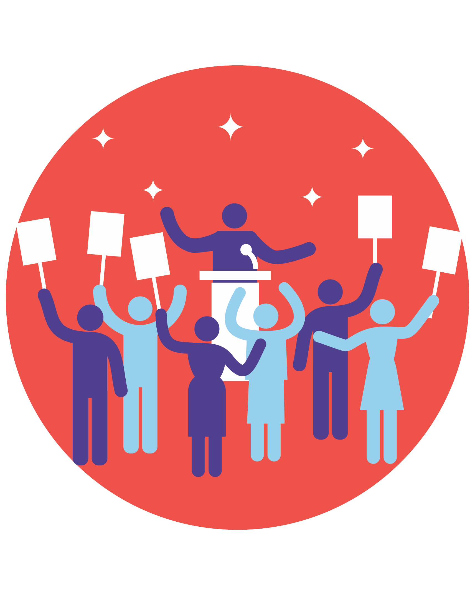
What is the PROBLEM?
Possible Concerns about the Current System
Sometimes it’s difficult and inconvenient for me to vote
There are too many efforts to suppress the vote in minority communities
Too many Americans don’t bother to vote and take democracy for granted
There seems to be too much voter fraud
Too often we end up with candidates who are too extreme
Something else?

Slide 6
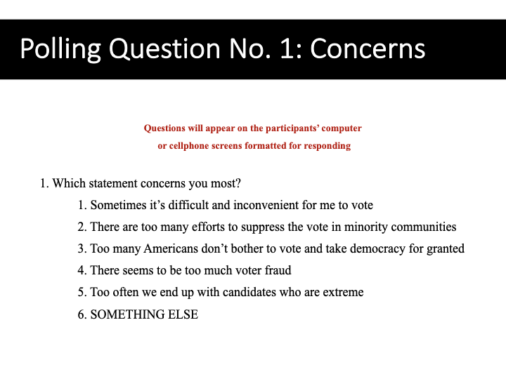

Slide 7
APPROACH 1:
Make It Easier
to Vote
Let’s make sure all
Americans get a chance to vote by keeping polls open longer and mailing paper ballots to all registered voters.
APPROACH 2:
Protect Against Cheating
Let’s prevent cheating by requiring photo IDs, limiting mail-in paper ballots, and cleaning up voting rolls to remove those who may have died or moved away.
APPROACH 3:
Change the System
Let’s create a system that gives us better elections and candidates by opening primaries to Independents, ending the Electoral College, and allowing ranked-choice voting.
But could these changes make it easier for people to cheat?
But could these changes make it more difficult to vote?
But could redesigning the election system have unintended consequences?
And . . . it’s unlikely everyone will agree. Few of us are likely to get all the changes we want.
So, let's look at these approaches in greater detail.

Slide 8
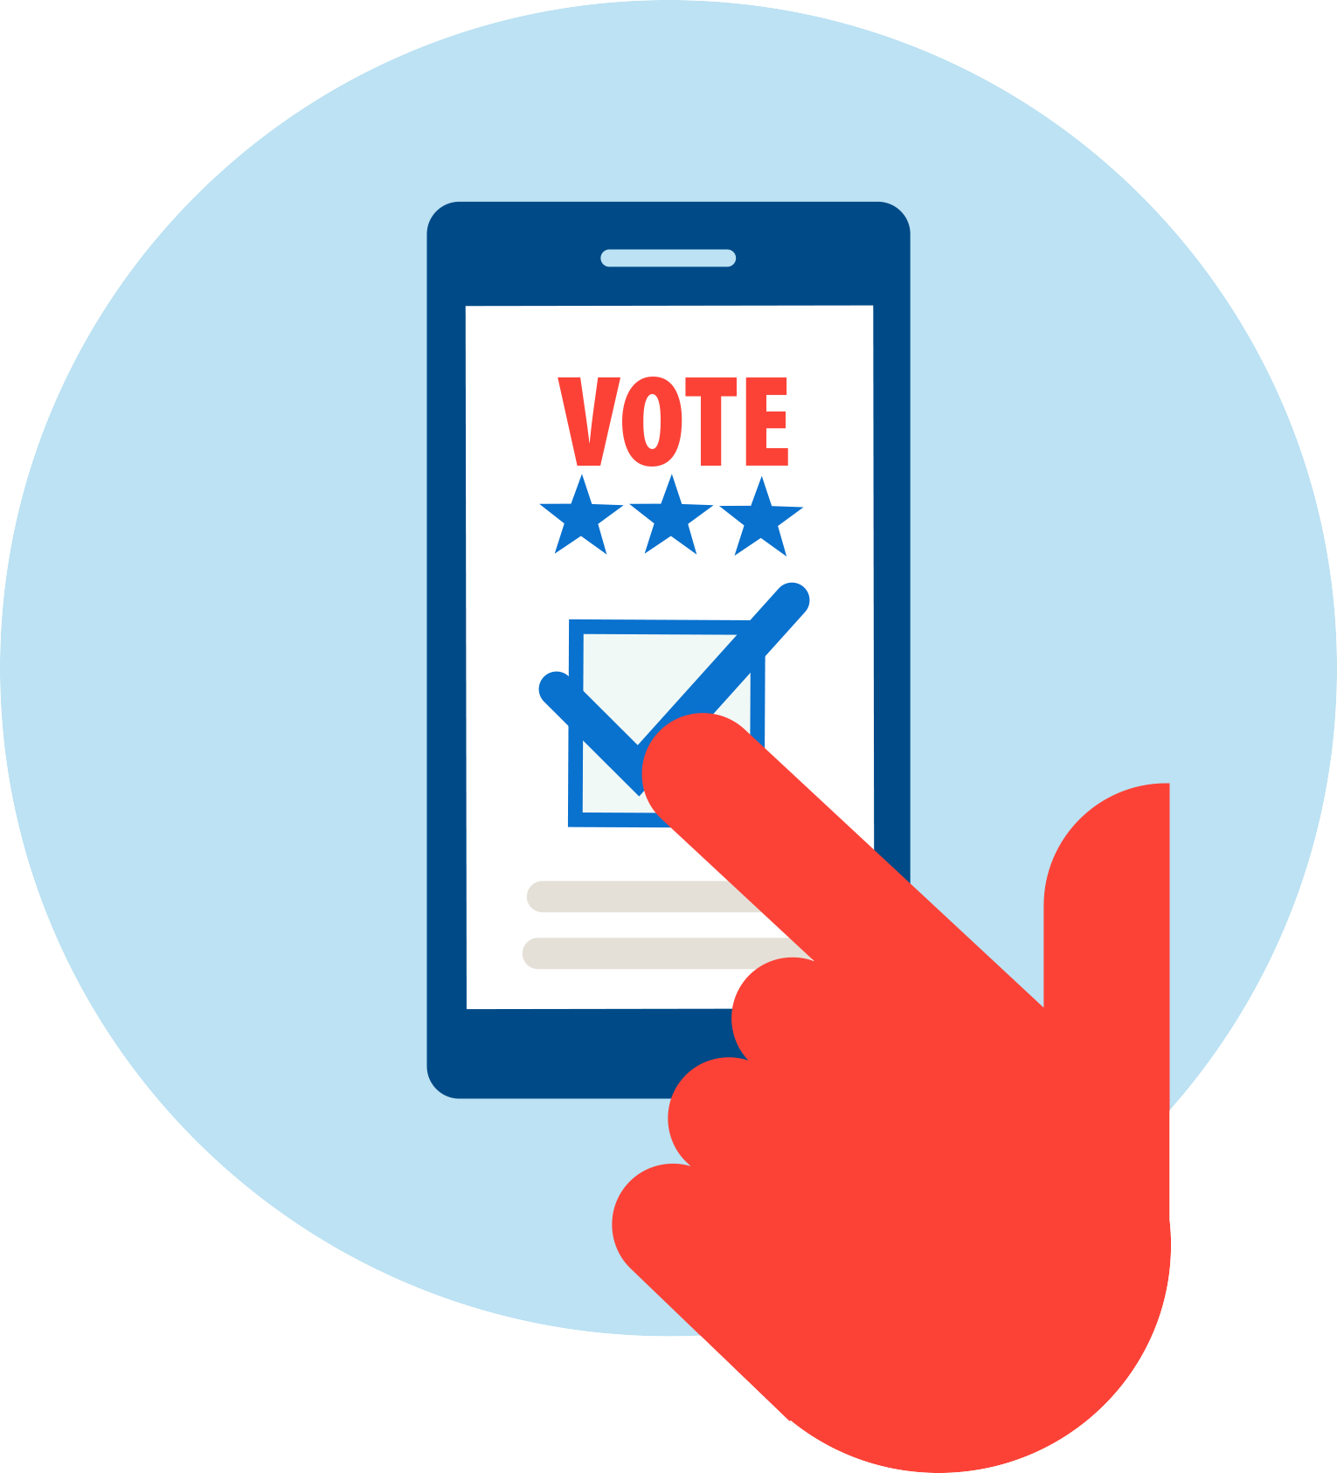
Make it easier to vote
APPROACH 1
Voting is one of the most important ways we improve our country, and it should
be simple and convenient. But if you work long hours or live far from a polling place
or face long lines or miss the registration date, you don’t have a fair chance. Given our
country’s low turnouts and history of voter suppression, our priority should be to make voting accessible to all.
ACTION ITEMS | POSSIBLE DRAWBACKS
Offer in-person early voting for extended hours and for two weeks before Election Day. | This is a huge cost for local governments, and people often wait until the last minute anyway.
Make Election Day a national holiday, as some other countries do. | This will hurt small businesses and won’t help essential workers such as nurses and firefighters.
Send mail-in ballots to all registered voters. Some states already do this regularly. | This means blanketing the state with paper ballots and makes it easier for people to steal or misuse them.
POSSIBLE DRAWBACKS
Other action items?
But how easy should it be? Is it truly unfair to ask people to make the time to go to vote?

Slide 9
Polling Question No. 2: Make It Easier to Vote
Questions will appear on the participants’ computer
or cellphone screens formatted for responding
2. Which action item do you favor most?
  Offer in-person early voting for extended hours and for two weeks before Election Day
  Make Election Day a national holiday
  Send mail-in ballots to all registered voters
  NONE OF THESE

Slide 10
Protect against cheating
APPROACH 2
Voting should represent the will of the people, and we should make changes to guarantee
the accuracy and security of our elections. We have too many out-of-date registration lists
and poorly monitored voting practices. The system is just too lax. Our priority should be to
ensure that all votes are cast legitimately and counted correctly. Making it harder to cheat
will give everyone confidence.
ACTION ITEMS | POSSIBLE DRAWBACKS
Require photo ID for voting, like we do to get on a plane. It’s more reliable than matching signatures. | This makes voting difficult for people who don’t drive or have another photo ID.
Only allow mail-in ballots for people who present a valid excuse, such as travel or illness. | Mail-in voting is much easier for those who work long hours or care for others. Limiting this option could reduce voter participation.
Remove people from voter rolls if they haven’t voted in the past five years. This helps eliminate the names of people who have died or moved. | Americans have the right to sit out elections. This causes problems for people when they do want to vote.
POSSIBLE DRAWBACKS
Other action items?
But we have a history of voter suppression and still see instances of people waiting hours in lines to vote. Shouldn’t states be required to make voting easier for everyone?

Slide 11
Polling Question No. 3: Protect Against Cheating
Questions will appear on the participants’ computer
or cellphone screens formatted for responding
3. Which proposal do you favor most?
  Require photo ID for voting, like we do to get on a plane
  Only allow mail-in ballots for people with a valid excuse, such as travel or illness
  Remove people from voter rolls if they haven’t voted in the past five years
  NONE OF THESE

Slide 12
Change the system
APPROACH 3
The problem is more fundamental—the current system seems engineered to limit voters’
choices. Politicians can draw Congressional districts to favor their own party. In some states,
primaries aren’t open to Independent voters. And presidential candidates can win the popular vote
but lose the election because of the Electoral College. These changes should be the priority.
ACTION ITEMS | POSSIBLE DRAWBACKS
Allow ranked-choice voting, where voters rank all candidates from most-favored to least-favored. | This could be confusing to voters and would require a significant voter education effort.
Eliminate the Electoral College and rely on the popular vote instead. | This requires changing the Constitution and gives voters in rural areas less say in the outcome. Candidates may ignore their concerns.
Let registered Independents participate in primaries for either party. This will give us more moderate candidates. | This damages the two-party system and will lead to a lot of candidates who try to please everyone.
POSSIBLE DRAWBACKS
Other action items?
But the US has benefited from a strong two-party system, and countries with many political parties are often unstable and ungovernable. Is it so smart to move away from our current approach?

Slide 13
Polling Question No. 4: Change the System
Questions will appear on the participants’ computer
or cellphone screens formatted for responding
4. Which proposal do you favor most?
  Allow ranked-choice voting
  Eliminate the Electoral College and rely on the popular vote instead
  Allow registered Independents to vote in primaries for either party
  NONE OF THESE

Slide 14
Here’s what we talked about…
In-person early voting
A national holiday
Send mail-in ballots to all voters
Require photo ID
Mail-in ballots only with a valid excuse
Remove names of those who haven’t voted for five years
Allow ranked-choice voting
Eliminate the Electoral College
Allow registered Independents to vote in primaries
Which 1 or 2 action items do you most FAVOR?
Which 1 or 2 action items do you most OPPOSE?

Slide 15
Polling Question No. 5: Most Favored Proposals
Questions will appear on the participants’ computer
or cellphone screens formatted for responding
5. Which one or two proposals do you most FAVOR? (multiple answers allowed)
  In-person early voting
  A national holiday
  Send mail-in ballots to all registered voters
  Require photo ID
  Only allow mail-in ballots for a valid excuse
  Remove if haven’t voted in past five years
  Allow ranked-choice voting
  Eliminate the Electoral College
  Allow registered Independents to vote in primaries

Slide 16
Polling Question No. 6: Most Opposed Proposals
Questions will appear on the participants’ computer
or cellphone screens formatted for responding
6. Which one or two proposals do you most OPPOSE? (multiple answers allowed)
  In-person early voting
  A national holiday
  Send mail-in ballots to all registered voters
  Require photo ID
  Only allow mail-in ballots for a valid excuse
  Remove if haven’t voted in past five years
  Allow ranked-choice voting
  Eliminate the Electoral College
  Allow registered Independents to vote in primaries

Slide 17
Results of Most-Favored and Most-Opposed Action Items
PROPOSALS | POLL QUESTION 5 - Which of the proposals do you most FAVOR? | POLL QUESTION 6 - Which of the proposals do you most OPPOSE?
In-person early voting | 2 | 0
A national holiday | 0 | 1
Send mail-in ballots registered voters | 4 | 1
Require photo ID | 1 | 0
Only allow mail-in ballots for a valid excuse | 0 | 4
Remove if haven’t voted in past 5 years | 0 | 4
Allow ranked-choice voting | 0 | 0
Eliminate the Electoral College | 2 | 0
Allow registered Independents to vote in primaries | 0 | 0

Slide 18
Areas of Common Ground
Where did we have common ground? Where were there areas of tension?

Slide 19
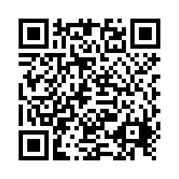
Survey QR code and link (link also in chat). Let us know if you'd like us to email you the survey.
https://uweauclaire.qualtrics.com/jfe/form/SV_bDXnb61Fi0lL5v8
Gift cards will be put in the mail in the next two days.

Slide 20
Thank you for participating!

